Slide 1
The Paint-Over
Digital Imaging and Painting | Judging what the machine made
Notes:
What this is. The lecture for session 12, the paint-over, which is the one generative exercise in this course. It fits the course as it stands: same session, same options. Milestone 2 (the value block-in for the frame extension) is collected at the start, as scheduled.
Running time, about 50 minutes. Milestone check and Spot it (6). Why this is a painting exercise (4). The painter's checklist, in painting order (18). The callout layer and the fix (10). Worked example and cold reversal (6). Your extension versus a generated one (4). Options (2).
Prep. The instructor-generated image set with typical errors (hands, light direction, perspective, mush), one per student plus spares, on Canvas, plus the second image for Option A. One image of your own, already called out and fixed, for the worked example, and one unfixed for the cold reversal. Slot images: a generated hand with errors, a generated image with even, everywhere detail, and the Pope puffer jacket image (2023 or so), shown in class.
If you also ran "What the Machine Is Doing" earlier in the course, skip the recap slide.

Slide 2
Spot it
One image. Ninety seconds.
What's wrong with it?
Say where, and what kind.
image: one of the instructor-generated images from today's set
Notes:
Spot it, about four minutes. Put the image up and say nothing for a few seconds. Then: what's wrong with it? Hands up, one error per person, and make them say where it is and what kind of error it is, in the checklist words once we have them (anatomy, perspective, light, lettering, repeated texture, sheen). Count the errors out loud as they come in. Don't confirm or correct until the room stops finding things, then add the one they missed, if there is one.
This opener runs every class. The point is repetition: by week four the room finds the shadow problem before the hand problem, which is the right order.
Use one of the images the students are about to work on. They get a head start, and you see what they catch on their own.

Slide 3
Milestone 2 is in
Value block-in, collected.
Today: someone else's image.
Back to your extension tomorrow.
Notes:
Milestone 2, your value block-in, is in. [Collect.]
Today is the one session in this course where we work on generated images. I made them at home, so nobody's generating anything. You'll be correcting them by painting, using everything from the first three weeks.
Tomorrow it's back to your own frame extension, and I think you'll find today useful for it, for a reason I'll get to at the end.

Slide 4
If you missed it: what these are
Built out of noise, steered by words.
Good at surfaces, bad at rules.
No decisions about light or focus.
Notes:
[Skip if you ran the earlier bridge lecture.]
A generator builds a picture out of noise, a little at a time, steered by words, using patterns absorbed from millions of captioned images. It's very good at surfaces: textures, materials, general mood. It's unreliable at things with rules: where the light comes from, one horizon, anatomy. And it makes no decisions about what should read first.
Which means its mistakes are painting mistakes.

Slide 5
The generator produced something.
Today's idea
The painter decides what's wrong with it.
Notes:
Here's the point of today, and it's the only reason this exercise is in a painting course.
The generator produced something. Your job is to decide what's wrong with it, and fix it with paint. That's judgment, and judgment is what this course has been training since the first squint test.

Slide 6
Why this is a painting exercise
Every error here is a painting error.
Value, light, form, edges, perspective.
You already have the words.
Notes:
Every error in today's images is one you already have a word for: a value structure that doesn't hold, a light that comes from two places, a cast shadow that falls the wrong way, edges that are all equally sharp, a horizon that doesn't agree with itself.
None of these are "AI problems." They're imaging problems, and the tool happens to produce a lot of them. Which means you don't need to learn anything new today. You need to look with what you already know.

Slide 7
The painter's checklist
1. Value structure (squint)
4. Edges and material
2. Light direction
5. Perspective and scale
3. Form: core and cast shadows
6. Anatomy and hands
Notes:
Here's the checklist for today, in painting order. Photograph it.
Value structure first, because if that's wrong, nothing else matters. Then light direction. Then form: are the core and cast shadows where the light says they should be? Then edges and material. Then perspective and scale. Then anatomy and hands.
Notice that hands are last. Everyone sees the hands first, because they're loud. A painter checks the big structure first, because that's where the image actually lives or dies.

Slide 8
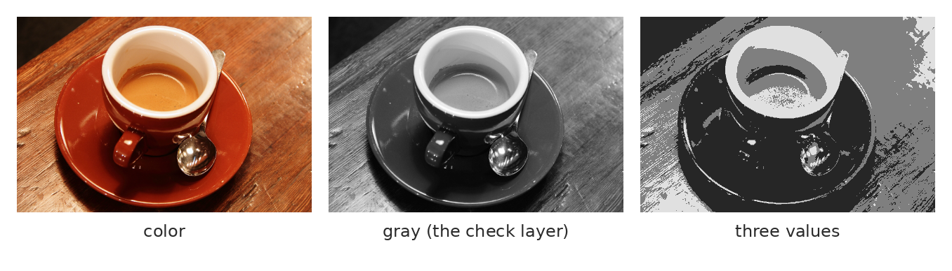
1. Value structure
Desaturate. Squint. Is there a light mass, a dark mass, a focal point?
Notes:
One: value, the squint test from session 2. Desaturate the image, or put a black and white adjustment layer on top, and squint.
Is there a clear light mass and a clear dark mass? Does something read first? Or is it medium against medium everywhere? Generated images are often the latter: plenty of color and detail, and in gray, nothing holds.
If the value structure fails, your first fix isn't a hand. It's a big, soft value pass: darken what doesn't matter, so the focal area can be the lightest or highest-contrast part.

Slide 9
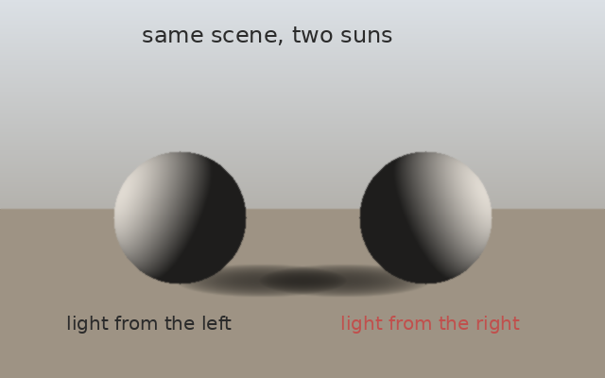
2. Light direction
Point at the light.
Every shadow agrees?
Highlights face the source?
Notes:
Two: light direction. Point at where the light is coming from. Literally point. Then check that every cast shadow falls away from that point and every highlight faces it.
Two suns, as here, is the classic generated error: each object lit convincingly on its own, the scene as a whole impossible. In the images today there's at least one of these. Most people never notice it. You will.

Slide 10
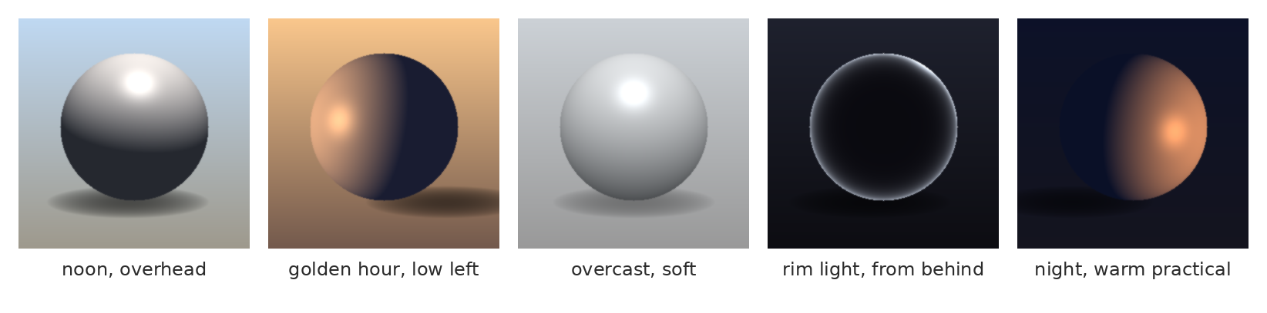
3. Form: core and cast
Light side, core shadow, cast shadow, bounce, highlight. In the right places?
Notes:
Three: form. Same as the primitives in session 3. Light side, core shadow, cast shadow, bounce light, highlight. Are they where the light says they should be, on every form?
Generated images often get the light side right and fumble the rest: the core shadow wanders, the cast shadow is missing or too soft, the bounce light is the wrong color for what it's bouncing off. Those are small paint fixes with big effects.

Slide 11
4. Edges and material
Everything equally sharp?
Hard, soft and lost: where?
Does metal read as metal?
image: a generated image with even, everywhere detail and uniform edges
Notes:
Four: edges and material, session 4. Generated images tend to have the same edge quality everywhere: everything equally sharp, equally detailed. There's no edge hierarchy, so there's no focus.
Your fix is to decide: hard edges at the focal point, soft edges where forms turn away, lost edges where things merge into shadow. And check materials: does the metal have a sharp highlight and a dark reflection, does the cloth have soft edges? Often the generator gets the texture of a material right and its edges wrong.

Slide 12
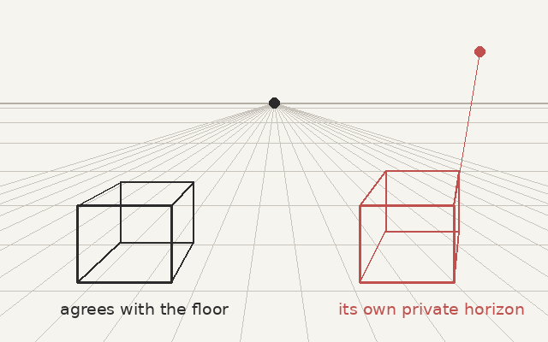
5. Perspective and scale
Find the horizon.
Lines agree with it?
Figures the right size?
Notes:
Five: perspective, which you've just been doing for your extension in session 11. Find the horizon line, check that receding lines go to vanishing points on it, check that figures are the right size for where they stand.
The fix is often not painting at all, but Transform and Warp on a part of the image, guided by a perspective grid on its own layer. Same as you'd do for your extension.

Slide 13
6. Anatomy and hands
Count the fingers.
Joints bend one way.
Shoot your own hand as reference.
image: a generated hand with errors (from today's set)
Notes:
Six: anatomy and hands. Count the fingers, actually count. Check the joints. Check that two hands belong to the same person.
The best fix: put your own hand in the same pose, light it from the same side, take a photo, and use it as reference, or mask it in and paint over it. Painters have used their own hands in a mirror as reference for centuries. This is that, with a phone.

Slide 14
Marking it up, then fixing it
Notes:
Now how the work goes in the file.

Slide 15
The callout layer
Lock the original
never paint on it
CALLOUT layer
circle and number
List
number, check, fix
FIX_ layers
one per fix
Notes:
Four steps, and the grade rests on them as much as on the paint.
Lock the original image layer and never paint on it. Add a layer called CALLOUT, circle and number each error. List them: number, which check it fails, what you'll do. Then each fix on its own layer, named for what it fixes: FIX_cast_shadow, FIX_left_hand, FIX_value_pass.
So anyone can turn the fixes on and off and see the before and after, which is what Option A asks for.

Slide 16
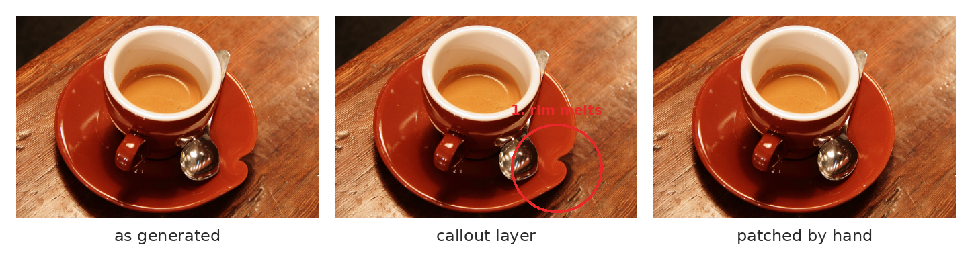
What it looks like
Generated, called out, fixed on its own layer.
Notes:
A simple example. As generated, the saucer's rim and the spoon melt into the table. The callout circles and numbers it. The fix is on its own layer, painted and cloned from the image's own material, and you can toggle it.
That's the whole session in three frames.

Slide 17
Fixing by painting
Structure, then light, then surface.
Sample color from the image.
Value first, then color.
Notes:
How to fix, and it's how you've been painting all month.
Order: structure first (value masses, perspective, anatomy), then light (shadows and highlights agreeing), then surface (texture, edges). Doing it out of order means doing it twice.
Sample your colors from the image itself, so the fix lives in its palette. And value first: get the light and dark right, then worry about the hue. A fix with the right value and a slightly wrong color usually disappears. The reverse never does.

Slide 18
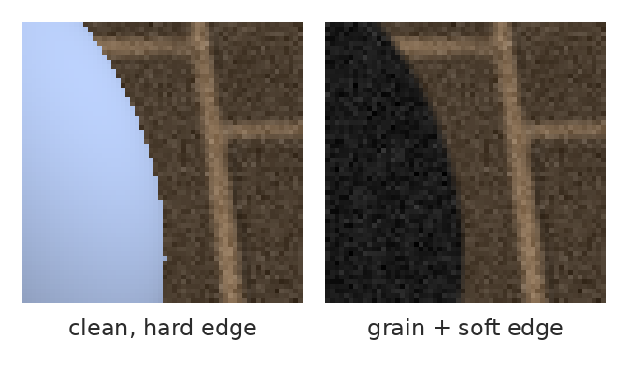
Make the fix disappear
Match the grain and the edge softness, at 100%.
Notes:
Last thing about fixing. Your paint is often cleaner than the image around it: no grain, crisp edges. Zoom to 100% and compare.
If the image has grain, add a little noise to your fix layer (Filter, Noise, Add Noise, monochromatic, a small amount). If the image is soft, soften your edges to match. It's the same matching you did in session 8 with photographs: light, color, grain, edges.
Sometimes your fix is better painted than the rest of the image, and that makes it stick out too. Match the image.

Slide 19
Worked example
Squint
value fails?
Point
where's the light?
Callout
number each error
Fix
structure, light, surface
Match
grain at 100%
Notes:
[Show your own worked example, before, callouts, fixed.] The order I worked in: squint first, and the value structure failed, so a big soft value pass came first. Then I pointed at the light and found the second sun. Then the callouts for everything else. Then fixes in order. Then matching at 100%.
Notice how much of the time was looking rather than painting.

Slide 20
Now you: plan the fixes
image: a second generated image from your set, unfixed
Notes:
Cold reversal. In pairs, two minutes. Go down the checklist on this one and plan the fixes: what's wrong, in what order would you fix it, and with what?
[Take two or three plans. Don't confirm. Ask which pair started with value and which started with the hands, and why.]

Slide 21
In the wild: the white puffer jacket
A famous fake, 2023 or so.
Millions believed it.
A painter would have caught it.
image: the generated image of the Pope in a white puffer jacket, 2023 or so
Notes:
[About three minutes.] You've probably seen this one: a generated image of the Pope in a huge white puffer jacket, which went around the world in 2023 or so, and which a lot of people believed.
[Ask: what gives it away?] The hand doesn't close around the cup. The glasses melt into the cheek. The light on the face is too even for the scene. Every one of those is on our checklist.
Nobody needed special software to catch it. They needed ten seconds of looking the way you've been taught to look in this course.

Slide 22
Your extension versus Expand
Expand fills the space.
You decide what the space says.
That's the whole final.
Notes:
One last thing, and it's why today matters for your final.
Photoshop has a feature that extends an image past its edges automatically. It fills the new space with something plausible: more sky, more room, more wallpaper. And mostly that's all it adds.
Your frame extension is graded on something the tool doesn't do: the new space has to change or add to what the image says, and you have to name that decision. That's the difference between filling space and composing it. The generator can fill. Only you can decide what the space is for.

Slide 23
Words from today
Paint-over – correcting an image by painting on new layers
Callout layer – numbered errors, on their own layer
Two suns – objects lit from different directions
Mush – detail everywhere, value structure nowhere
Edge hierarchy – hard at the focus, soft and lost elsewhere
FIX_ layer – one correction, named for what it fixes
Notes:
Thirty seconds. Read the terms aloud and ask the room for any they can't explain yet. These are on Canvas as a running glossary, which helps everyone and helps accommodated students most, on a schedule where the next class is often tomorrow.

Slide 24
Before next class: pick one
Option A, guided
Option B, own material
A second paint-over
on a provided image.
Each fix on its own named layer.
Short written comparison: three things
the generator got wrong and how you
fixed each, with layer names.
Notes:
Before next class, the same options as in the course outline for this session.
Option A: a second paint-over on the provided image, each fix on its own named layer, with the callout layer above.
Option B: a short written comparison: three things the generator got wrong in your image from today, and how you fixed each one, with the layer names. Write it in painting terms.
Same rubric. Tomorrow, back to your frame extension, color pass coming up.

Slide 25
Most people see the hands.
One line to take home
A painter sees the shadows.
Notes:
Most people see the hands. A painter sees the shadows. [Demo: one image, called out and fixed, out loud, starting with the squint.]

